Slide 1
AI
Friend or foe?
For Software Developers
Presented By:
Amthal Rezia Rasha Name Name Name
115272254 id id id

Slide 2
Table of Content
01 | Introduction
02 | The Advantages
03 | The Disadvantages
04 | Future of Developers and AI
05
What to expect in this presentation?

Slide 3
The Rise of AI in Technology
Artificial Intelligence (AI) has rapidly transformed numerous industries, and software development is no exception. Some aspects that AI is being used in:
AI tools are becoming integral parts of the development workflow. Some might say developers are becoming AI dependent.
Why now in 2025:
Mature AI Tech
Increased Computing Power
Widespread Adoption

Slide 4
Impact on Efficiency
Before AI
After AI
Handwritten Boilerplate
Manual Bug hunting
Slow test Scaffolds
AI drafts boilerplate
Suggests small refactors and lint fix
Proposes test cases

Slide 5
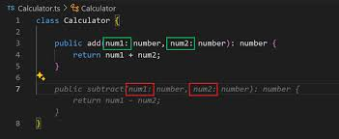
Example
AI is advanced enough to suggest functions that it expects the user to write next.

